Slide 1

Dive into Data: Building a Security Data Lake on AWS
GRASSr00tz, 2023 Appleton, WI
Ryan Victory

Slide 2
YOU can start gaining immediate insights into your security data and begin threat hunting at scale. My goal is for you to begin thinking about how data warehousing can turbo charge your security program.

Slide 3

Data Enables Security Success
01 FRAMING THE PROBLEM
Threat Hunting
Incident Response
Performance and Metrics
Decision-making
Threat Intel
Risk Assessment
Forensics
Compliance

Slide 4

Diverse data sources of varying sizes
01 FRAMING THE PROBLEM
Windows Events
Syslog
Web Servers
Network Security Monitors (NSM) (e.g., Zeek, Suricata, etc.)
Firewalls
Endpoints
What data do you have “lying” around?

Slide 5

Using data seems hard and expensive
01 FRAMING THE PROBLEM
SIEMs are often limited and charge by the data volume
Data can feel so large it seems impossible to use
Vendor lock-in can make data problems even worse

Slide 6

Data Silos Are Bad
01 FRAMING THE PROBLEM
Your security data might live in a bunch of different places
Some data may only be accessible in a specific location or system, making it impossible to combine with your other data

Slide 7

The Solution: A Security Data Lake
01 FRAMING THE PROBLEM
All your data in one place
Far easier to analyze and query
AWS provides affordable and effective managed solutions to get started quickly

Slide 8









An AWS Security Data Lake
02 THE AWS SECURITY DATA LAKE
Corporate
data center
AWS Cloud
Writes to
Uses Schema
Network Security Appliances
to write data to
Writes to
Amazon Kinesis Data Firehose
AWS Glue Data Catalog
Amazon Simple Storage Service (Amazon S3)
Other log sources
to query data in
Uses Schema
Query
Amazon Athena
Security Teams

Slide 9
Principles and Disclaimers
02 THE AWS SECURITY DATA LAKE
Can be configured in a “click together” manner via the AWS Console UI or via the CLI or other automation services
AWS Security is up to you
We’re covering the concepts, not the step-by-step
There are tons of AWS services you can add on to improve or simplify this process
AWS costs money, but maybe not too much money…

Slide 10
An Affordable Security Data Program
02 THE AWS SECURITY DATA LAKE
Assume 10TB of log data stored (that’s 10 billion log lines at 1KB per line, uncompressed)
50 million log lines ingested per day at 1KB each and converted to a warehouse format
100 queries per day scanning 10GB of data each on average
$235.52/month
$340.83/month
$148.54/month
$724.89/month total

Slide 11
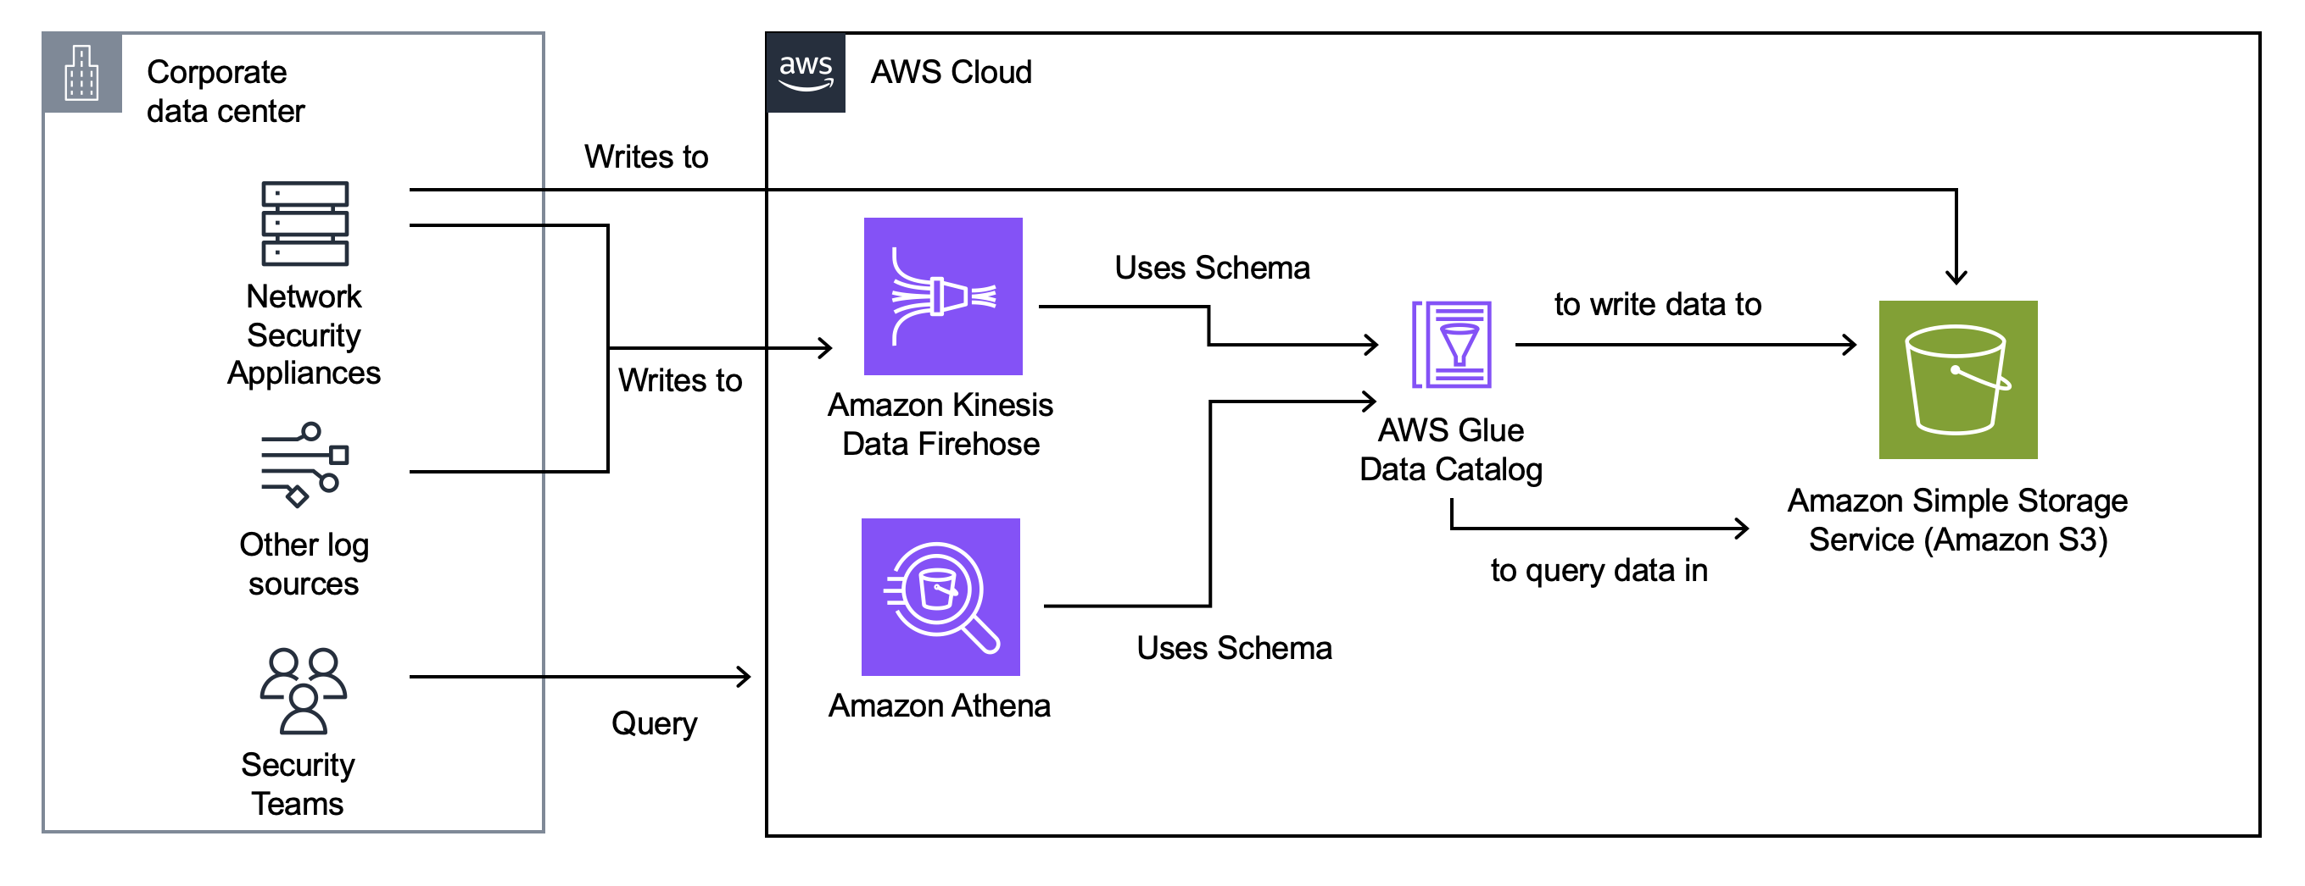
Data Storage: AWS S3
02 THE AWS SECURITY DATA LAKE
Where our data will live
“Tables” are represented as “directories”
Data is stored in files (such as CSV, TSV, JSON, or data warehouse specific formats such as Parquet)
We can directly upload our data files into S3 in batch or stream data into S3…

Slide 12
Real time Data Ingest: Kinesis Firehose
02 THE AWS SECURITY DATA LAKE
Receives data in near real time and writes it in batches to S3
Useful when we have a lot of data being produced quickly and we want to be able to query it or work with it as soon as it’s available
Simple APIs to write data and many system support writing to it

Slide 13

Data Schema: AWS Glue
02 THE AWS SECURITY DATA LAKE
Glue is where we “glue” together the data in S3 with the table structure of our data warehouse
Glue maps out our tables and the columns in those tables
Services such as Kinesis Firehose use Glue to know how to write our data to S3

Slide 14
Data Retrieval/Hunting: AWS Athena
02 THE AWS SECURITY DATA LAKE
Athena is how we will query the data in our warehouse
Runs on Presto, a distributed SQL engine
Queries are written in Presto SQL, an expressive and powerful query language
Allows us to join data across multiple tables and sources
Can integrate with BI or other query tools or dashboards

Slide 15

Data Examples
02 THE AWS SECURITY DATA LAKE
S3 Upload
Hourly DHCP logs into S3
Daily Netflow logs from a Netflow collector
Daily export of your asset inventory
Daily export of your vulnerability assessments
Streaming (Firehose)
NSMs logs (Zeek, Suricata, etc.)
Web Server logs
Firewall logs
Windows Event Logs
LDAP/Domain Controller Logs

Slide 16
Why an SQL-based Security Warehouse?
02 THE AWS SECURITY DATA LAKE
SQL is a standard language for data analytics at scale
Leverage existing data science talent
Expressive, easy to read, and powerful
Avoid vendor lock-in

Slide 17
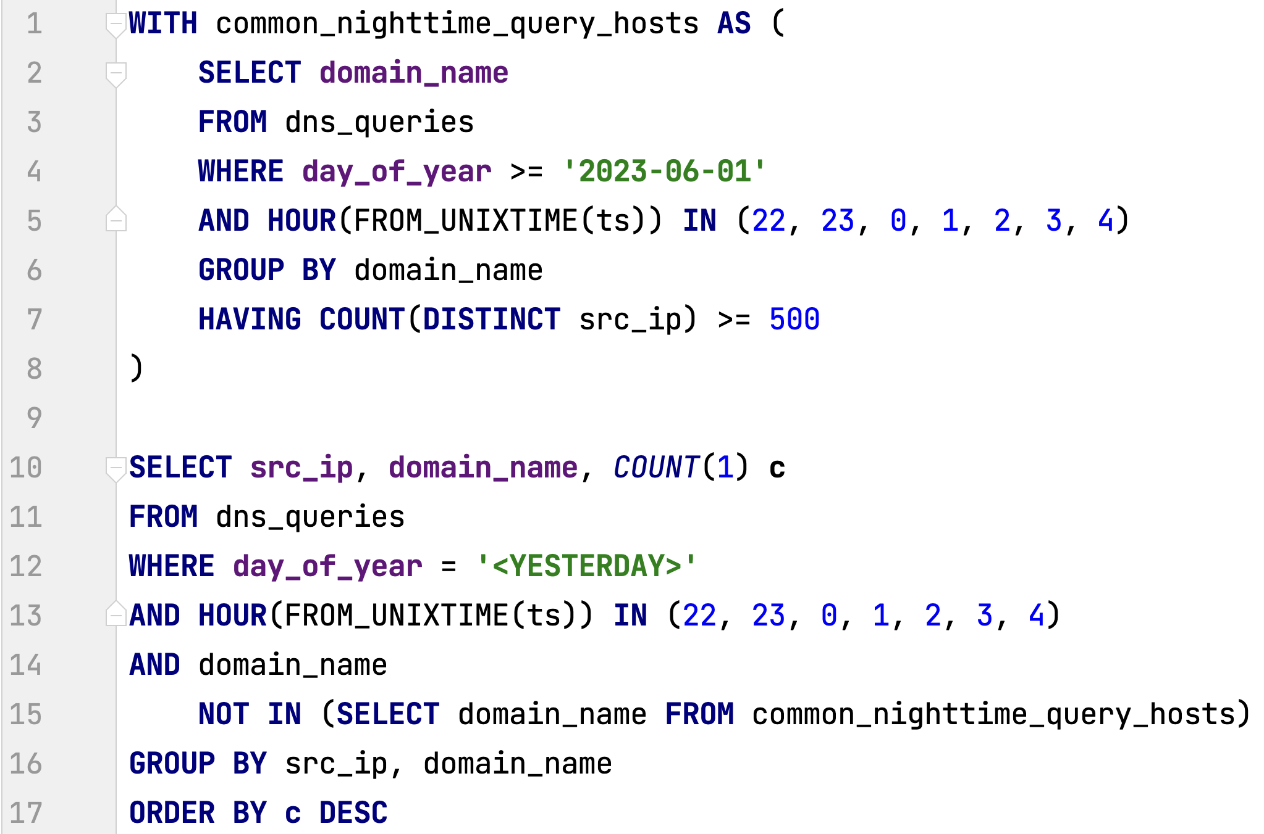
Threat Hunting
03 PUTTING OUR LAKE TO USE
Complex behavior expressed as queries across multiple data sources
Queries can be run ad-hoc or on a regular basis
Example: Find hosts querying uncommon domain names at night

Slide 18
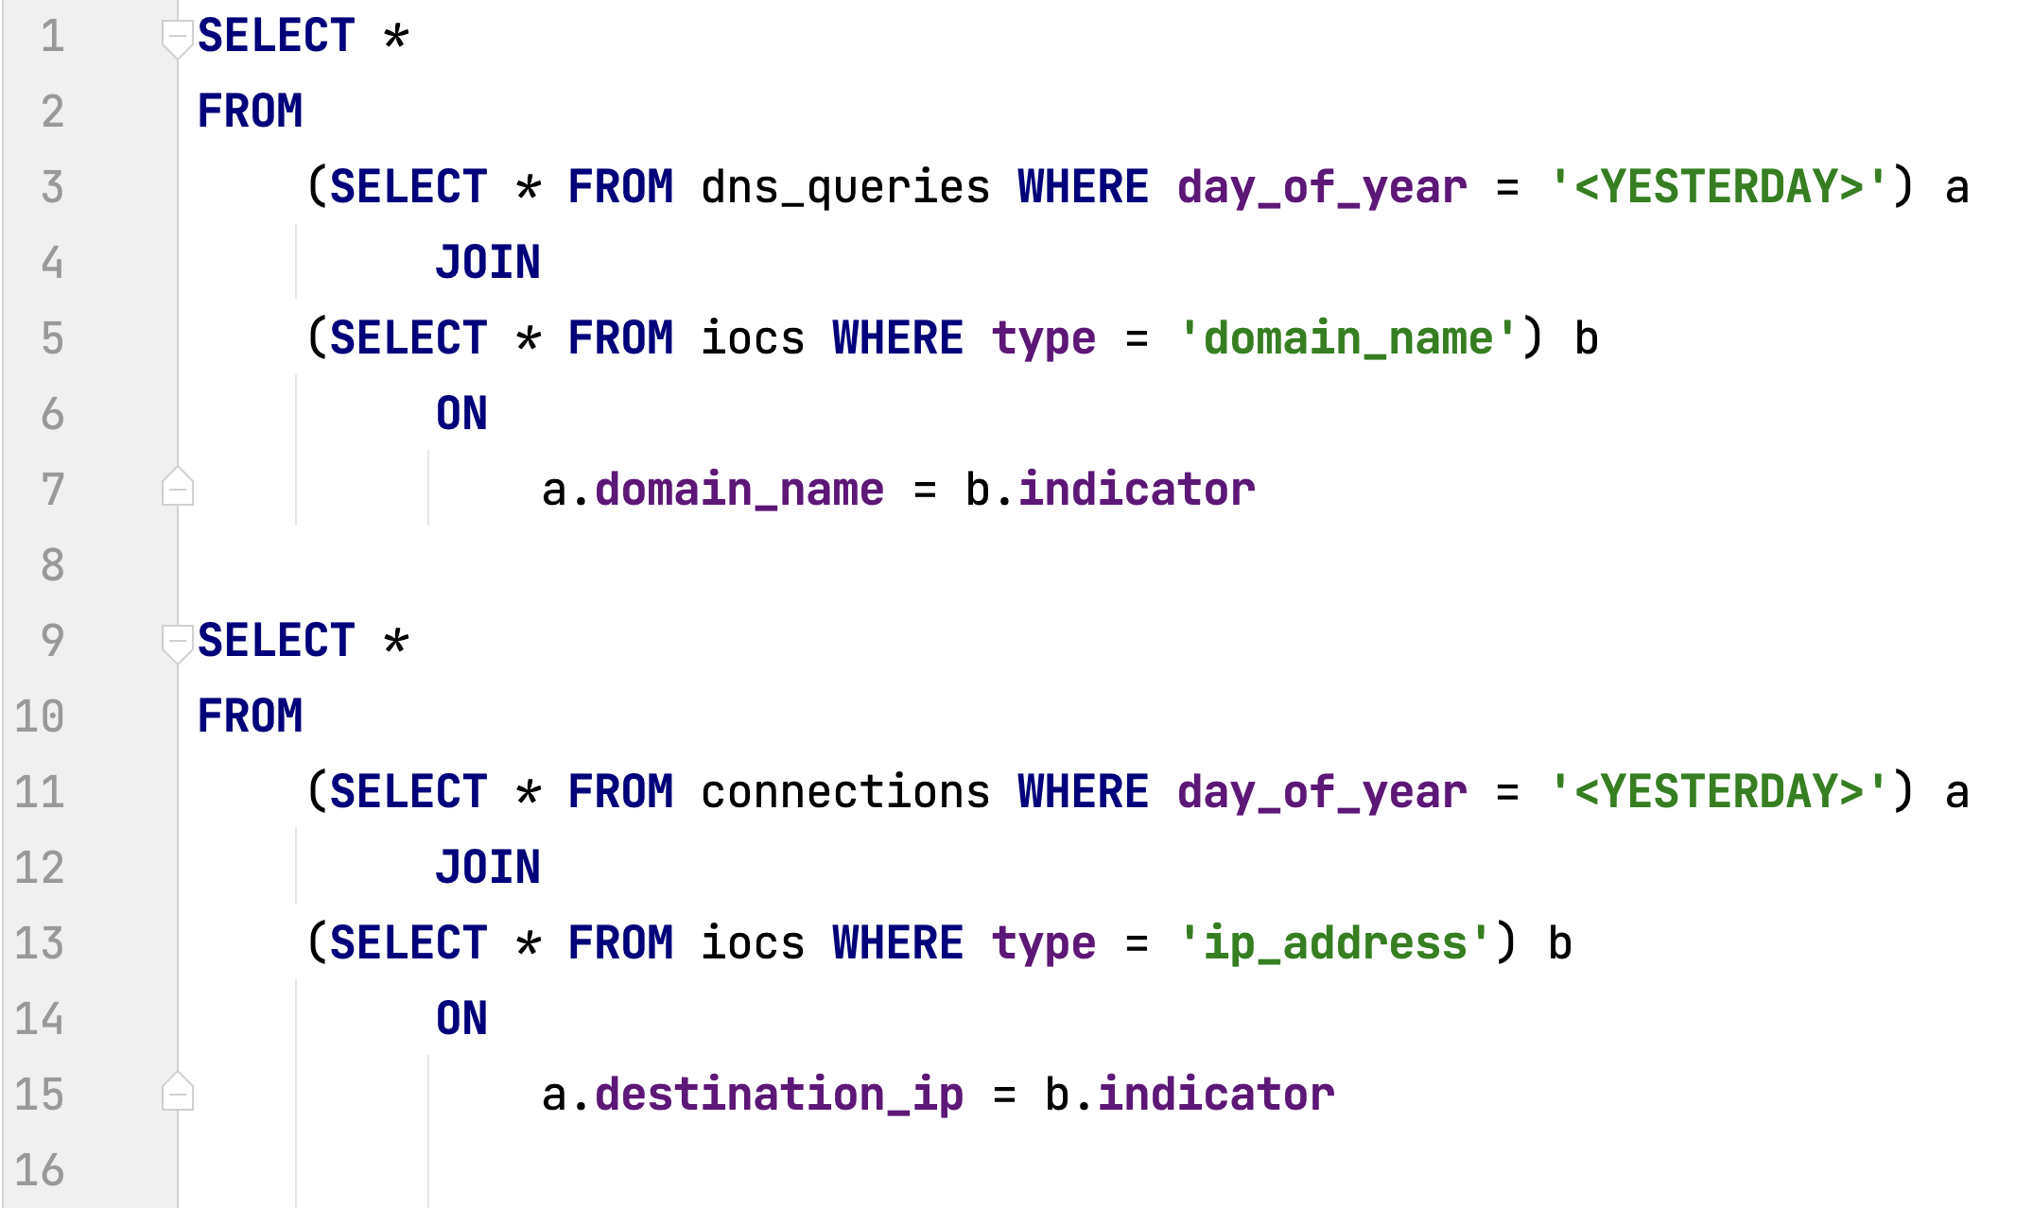
IOC Monitoring
03 PUTTING OUR LAKE TO USE
Monitor for known IOCs from feeds, sharing groups, news, etc.
Query new and historical data
Look back in time when new IOCs are added
Example: DNS queries or connections to known bad domain names or IPs

Slide 19
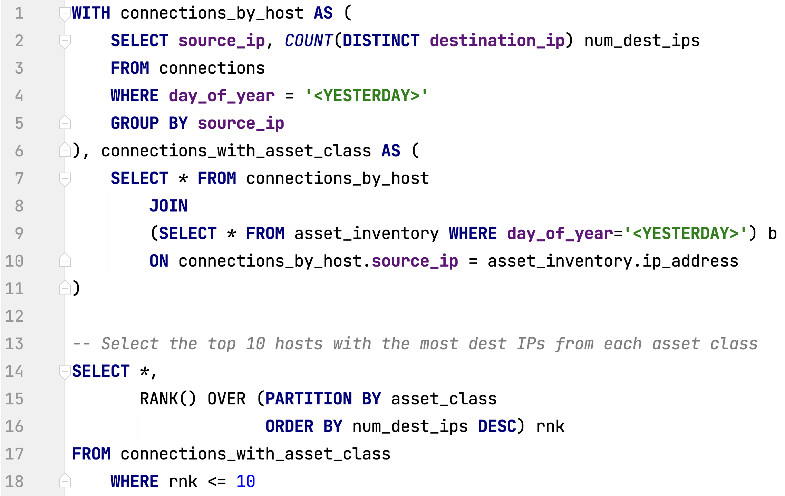
Anomaly Detection
03 PUTTING OUR LAKE TO USE
Use data to baseline what’s “normal” and find anomalies
Example: Find the top 10 hosts in each inventory asset class with the most outbound connections in a day

Slide 20
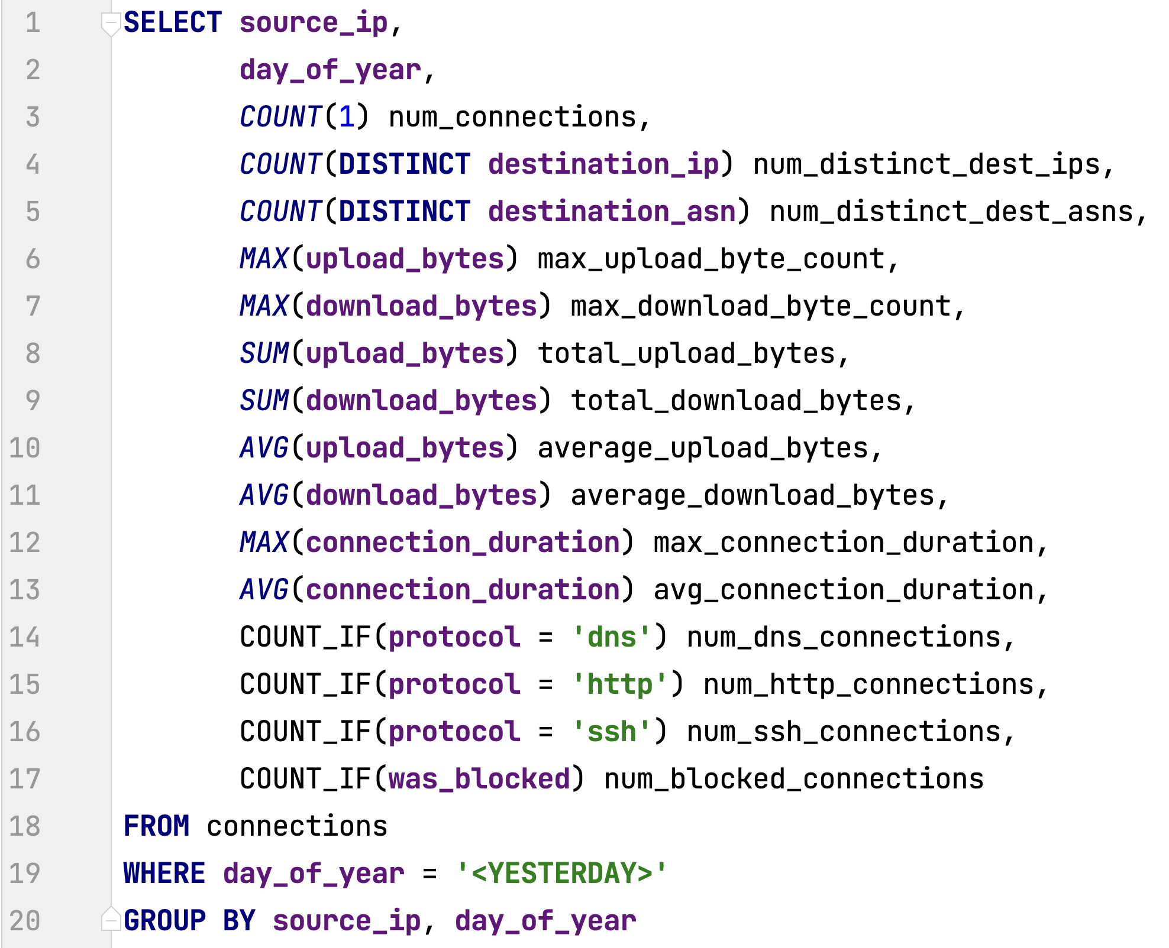
Summary Tables and Enriching Data
03 PUTTING OUR LAKE TO USE
Calculate and store large amounts of stats for future hunting and other analytics needs
Example: Daily statistics for our internal hosts to enable us to find anomalies or to understand how changes might affect the network in the future

Slide 21

Other Opportunities
03 PUTTING OUR LAKE TO USE
Analytics Notebooks
Scheduled/Automated Queries
Machine Learning and AI
Enrichment using third party data (e.g., GeoIP, IP Reputation, etc.)

Slide 22

Thank you!
Ryan Victory
ryan@malware.net
https://beerandraptors.com

